Slide 1
MVC Architectural Pattern

Slide 2
Overview
What is MVC
MVC vs. OO design
MVC Pattern
Separation Of Concerns
MVC Advantages
ASP.NET MVC
Static Versus Dynamic websites
Static websites
Dynamic websites
MVC Dynamic websites
Web request Process flow

Slide 3
MVC
Some common questions that arise when starting MVC
What EXACTLY is MVC?
Where does MVC fit into software Development?
What is the relationship between OO and MVC?

Slide 4
MVC
MVC (model-view-controller) is an architectural pattern
Helps us to organise software components/objects into a working application
Independent of software language, code or OS
MVC is not code!! It’s a pattern, a way of organising/dividing problem space into distinct independent areas
Helps us to divide up an application into 3 separate distinct areas
Domain = business data and rules - Model
Presentation = displaying of business info - View
User interaction = interactions with our system - Controller

Slide 5
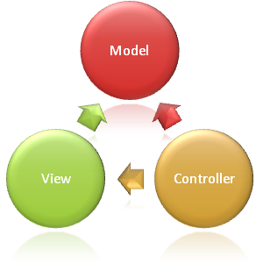
MVC
The Model-View-Controller (MVC) architectural pattern separates an application into three main components:
the model (Business Logic)
implement the logic for the applications data domain.
Often, model objects retrieve and store model state in a database
In small apps the database class (e.g entity classes will be the model)
the view (UI logic)
the components that display the applications user interface (UI)
In web app this often means generating HTML to display in browser
Typically, this UI is created from the model data
Views should concentrate only on displaying data and should not contain any business logic
the controller (Input Logic)
The components that handle user interaction, work with the model, and ultimately select a view to render that displays UI.
Controllers receive input from users via the view, then work with the model to perform specific actions, passing the results back to the view.
SOC (Separation of concerns) : MVC helps you create applications that separate the different aspects of the application (input logic, business logic, and UI logic), while providing a loose coupling between these elements.

Slide 6
MVC vs OO design
OO Design
Coding : Break up problem into classes(objects) that represent your system
e.g Classes in a banking App
MVC Pattern
Organising all the objects into manageable chunks
Model
Customer
BankAccount
Bank Account
Properties
Methods
Customer
Properties
Methods
AccountDisplay
Properties
Methods
DatabaseAccess
CreditCard
Payments
UserInput
Properties
Methods
CreditCard
Properties
Methods
Bankstatement
Properties
Methods
View
Controller
AccountDisplay
UserInput
Payments
Properties
Methods
DataReport
Properties
Methods
Database Access
Properties
Methods
DataReport
Bankstatement

Slide 7
MVC Pattern
MVC pattern is not new (dates back to 1978 & Smalltalk) but gaining popularity with web-apps because :
User interaction with MVC follows a cycle :
User takes an action,
In response the application changes its data model
& delivers an updated view to the user
Cycle repeats
(very convenient fit for web applications delivered as series of HTTP requests and responses)

Slide 8
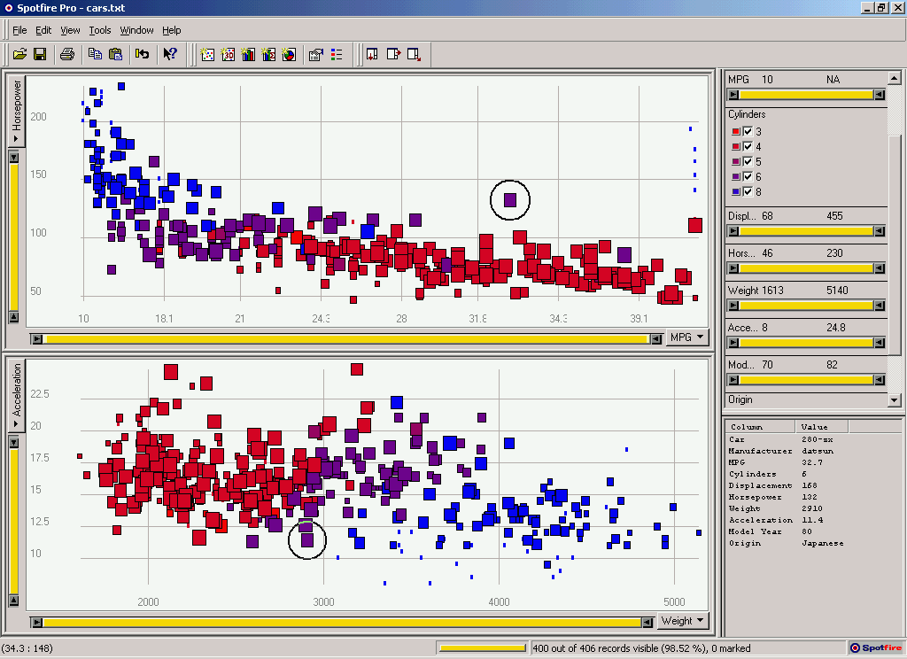
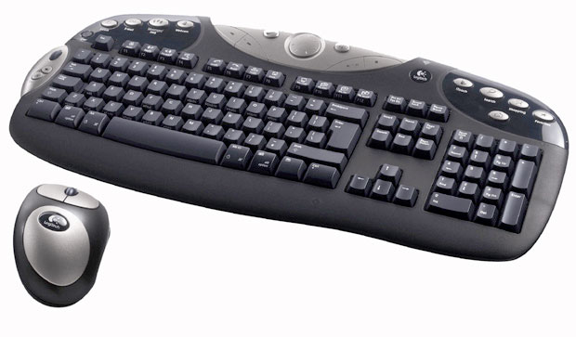
Model-View-Controller (MVC)
User input
View
Controller
Data display
UI:
Model
Data model
(& business rules)
Data:
Notes:
MVC pattern is not new (dates back to 1978 & smalltalk) but gaining popularity with webapps because :
User interaction with MVC follows a cycle
User takes an action,
In response the application changes its data model
& delivers an updated view to the user
Cycle repeats
(very convenient fit for web applications delivered as series of HTTP requests and responses)

Slide 9
SOC (Separation of concerns)
Separation between the data layer and the interface is the key:
The view is easily replaced or expanded.
Model data changes are reflected in all attached views because all views are observers.
Better scalability since UI and application logic are separated.
Distribution over a network is greatly simplified (because application is split up).
Notes:
When the implementation is sufficiently discrete, the interface can be entirely replaced.
Since the Model encapsulates both state and logic, state changes made by one interface can be seen in others.

Slide 10
Advantages
Development
Individual components do not directly depend on other components => components can be developed in isolation
Testability
Loose coupling of components means you can substitute real components for test/mock components (e.g. avoid making actual calls to database by replacing them with hardwired data)
Maintenance
Isolated components means changes are typically isolated to a small number of components (no unknown knock on effect)
Multiple views for a model
Multi-view applications
Different users can get different view of same models
Different UI platforms (mobile, client-side, server-side,…)

Slide 11
ASP.NET MVC

Slide 12
ASP.Net MVC
The ASP.NET MVC framework is a lightweight, highly testable presentation framework that (as with Web Forms-based applications) is integrated with existing ASP.NET features, such as master pages and membership-based authentication.
defined in the System.Web.Mvc namespace

Slide 13
ASP.Net MVC
To understand ASP,NET MVC it is useful to understand how a requested webpage is formed and returned to the user
In turn its useful to understand :
Static versus dynamic websites

Slide 14
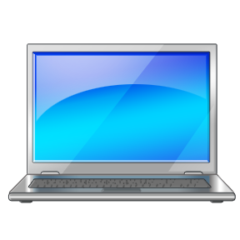
Pre MVC : Static Website
Website (on webserver)
Request for
www.site.com/about.html
about.html
User types webpage address into browser
<HTML>
<BODY>
Hi Welcome
</BODY>
</HTML>
<HTML>
<BODY>
Hi Welcome
</BODY>
</HTML>
About.html page returned
<HTML>
<BODY>
Hi Welcome
</BODY>
</HTML>
Page content never changes, always the same for each user, each time

Slide 15
Pre MVC : Dynamic Website
Website (on webserver)
Request for
www.site.com/news.html
News.aspx
<HTML>
<BODY>
Latest news :
<% dynamic content %>
</BODY>
</HTML>
User types webpage address into browser
function Page_Load()
{
CODE…
}
<HTML>
<BODY>
Latest news : its bad
</BODY>
</HTML>
RENDERED news.aspx page returned
<HTML>
<BODY>
Latest news : its bad
</BODY>
</HTML>
Database
CODE BEHIND File
creates dynamic HTML , ‘on the fly’ when requested

Slide 16

MVC : Dynamic Website
Routing
News = Controller name
Ireland = Controller method
Website (on webserver)
Dynamic
www.site.com/News/Ireland
Controller
Model
Class NewsController
{
public Ireland()
{
get Model
return view(model)
}
}
Class NewsData
{
string title
string date
}
User types webpage address into browser
Model
Database
View
<HTML>
<BODY>
Latest news : its bad
</BODY>
</HTML>
NEWSView
<HTML>
<BODY>
Latest news : model.title
</BODY>
</HTML>
RENDERED news page returned
<HTML>
<BODY>
Latest news : its bad
</BODY>
</HTML>
Model

Slide 17
ASP.NET MVC Web Request process flow

Slide 18
What is ASP.Net MVC ?
www.site.com/News/ireland
Request
Controller
Step 1
Incoming request directed to Controller

Slide 19

What is ASP.Net MVC ?
Request
Controller
Model
Step 2
Controller processes request and retrieves a data Model

Slide 20
What is ASP.Net MVC ?
Request
Controller
View
Step 3
Model is passed to View

Slide 21
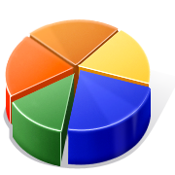
What is ASP.Net MVC ?
Request
Controller
View
Step 4
View transforms Model into appropriate output format

Slide 22
What is ASP.Net MVC ?
Request
Controller
View
Response
Step 5
Response is rendered

Slide 23
What is ASP.Net MVC ?
Step 1
Incoming request directed to Controller
Step 2
Controller processes request
and retrieves a data Model
Request
Controller
Model
Step 3
Model is passed to View
Step 5
Response is rendered
View
Response
Step 4
View transforms Model into appropriate output format

